Slide 1
360 Education Business Analytics Platform Power BI End-to-End Business Intelligence Project
Prepared by: Ankita Dongare
Batch: DA603
Trainer: Mr. Vaibhav Bhambere Patil
Tools: MySQL | Power BI | DAX | Power Query

Slide 2
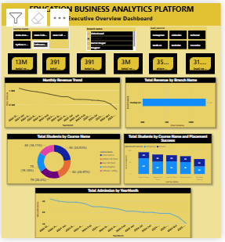
EDUCATION BUSINESS ANALYTICS PLATFORM Executive Overview Dashboard

Slide 3
Key Insights:
Top Revenue Branch: Pune Top Revenue Course: Data Science Highest Admission Month: January Overall Placement Rate: 72% Pending Fees: ₹14M
Recommendation:
Focus marketing efforts on high-performing courses.
Investigate why low-performing branches generate less revenue.
Increase campaigns before high-admission months.
Strengthen placement support for courses with lower placement rates

Slide 4
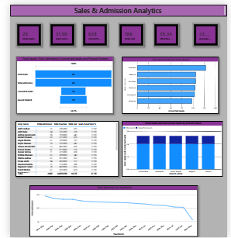
Sales & Admission Analytics

Slide 5
Area | Finding
Best Lead Source | LinkedIn
Best Counselor | Counselor A
Best Branch Conversion | Pune
Conversion Rate | 26%
Effective Call Rate | 72%
Recommendations
Increase investment in high-converting lead sources.
Study the working pattern of top-performing counselors.
Provide additional training to low-performing counselors.
Improve follow-up for ineffective/unconverted leads.
Focus campaigns on branches with strong conversion rates.

Slide 6
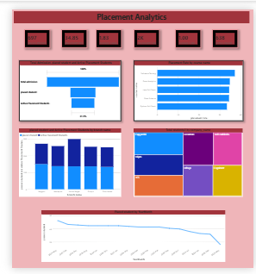
Placement Analytics

Slide 7
Key Findings
Highest placement rate: Data Science
Highest recruiting company: Company A Best placement branch: Pune Average salary: ₹52K Active placement students: 320
Recommendations
Build stronger relationships with companies recruiting frequently.
Increase placement drives for courses with low placement rates.
Provide additional interview preparation to active placement students.
Track placement calls per student to identify students receiving fewer opportunities.
Use salary trends to improve course positioning.

Slide 8
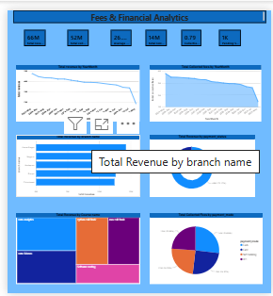
Fees & Financial Analytics

Slide 9
The company generated approximately 66M revenue, of which around 52M has been collected, leaving approximately 14M pending.
The collection efficiency is around 79.45%, meaning a significant portion of the expected fees has been collected, but approximately 20% remains outstanding.
14M pending fees is important because delayed collection can affect the company's cash flow.
Financial Recommendations
Reduce Pending Fees
Monitor High-Pending Branches
Monitor Payment Modes
Improve Collection Efficiency
Track Payment Status

Slide 10
Your current dashboard indicates:
66M revenue → 52M collected → 14M pending
Thank You

